Slide 1
Performance Similarity Based Method for Enhanced Prediction of Manufacturing Process Performance
Dr. Jianbo Liu, Michigan State University
Dr. Dragan Djurdjanovic, Univ. of Texas
Prof. Jun Ni, Univ. of Michigan
Prof. Jay Lee, Univ. of Cincinnati

Slide 2
Presentation Outline
Introduction
Method Overview
Experimental Results
Conclusions and Future Work

Slide 3
The Concept of Feature Based Prediction
F(0)
F(1)
F(2)
F(N)
F_{N}(1)
F_{N}(2)
F_{N}(3)
time
t = 0
t =1
t =2
…
t =N
t=N+1
t=N+2
t=N+3
Past
Present
Future
Normal Behavior
Model of Failure
F(t)=[f₁(t) f₂(t)], t=1,2,3,…,N
Feature f₂
Legend
Predicted Probability of Failure
Past Performance Signatures
0
Predicted Confidence Value
Prediction
Prediction Uncertainty
Feature f₁

Slide 4
Motivation
Time
Run 1
Run 2
Run 3
Run 4
New Run
:Maintenance
Feature 2
?
Run
:Time period between two maintenance operations such as component replacement
Operation cycle
:Repetitive operation, such as printing one sheet of paper, drilling one hole
Feature 1
Normal
Features
:A set of values selected to describe component conditions
Normal feature distribution
Notes:
Assume the machine condition are described by features.
What is run:
one run may contain many operation cycles;
What is features?
Degradation process can be described by a sequence of feature vector.

Slide 5
Problem Statement
Exploit behavior similarities observed in the historical records to achieve
Accurate long term prediction of time-series of performance features
Ability to predict behavior of time series of performance features that are
non-stationary
non-linear
non-Gaussian

Slide 6
Creation of Match Matrix
FV of New
cycle j
FV of
cycle N
latest FV
Past Run m
Current run
FV of
cycle i
Past
run 1
2
FV of
cycle 1
j
Current run
m
FV: Feature vector
Updating Match Matrix
Notes:
To implement this idea first thing we need to do is to compare two different runs. Match matrix are thus created to compare the current run with the past runs. Each element in the match matrix represent the similarity between one feature vector in cur run and another feature vector in past run

Slide 7
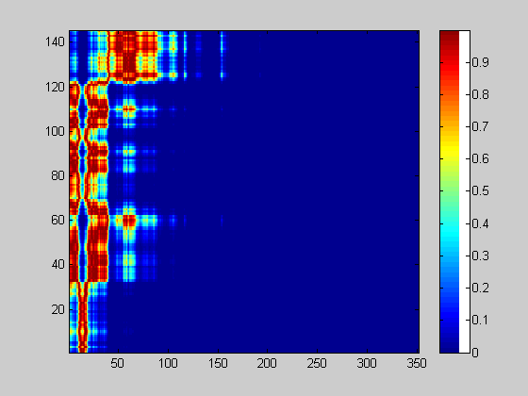
Concept of a “Match Matrix”
Position (i₂,,j) in the Match Matrix
Low match between signal number i₂ from the previous run and signal number j from the current run.
Current Run Signal Number
Position (i₁,,j) in the Match Matrix
Strong match between signal number i₁ from the previous run and signal number j from the current run.
Previous Run Signal Number

Slide 8
Similarity Analysis Using Expected Indices of the Best Match
N
Past run
E(index)
1
1
i
j
1
i
j
1
ith column in match matrix
k
i represent the index of the signal in the current run (index of the column)
N
Notes:
In IAB6 an very important modification to match matrix based prediction process is instead of using the raw index of best match, we use the mean index of best match to do the prediction.
Consider the ith column of the match matrix, it represent …… Imagine that the highest similarity with concentrate at some index region. Remiand you how we have done it
capture the dynmics and predict the feature behavior. T
Smooother andeasy to predict

Slide 9
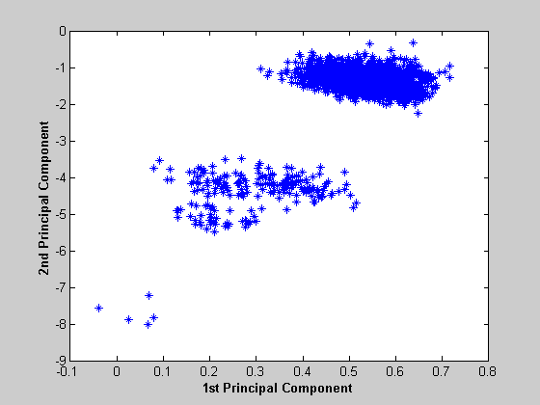
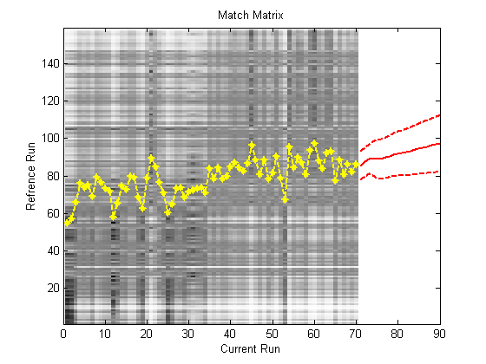
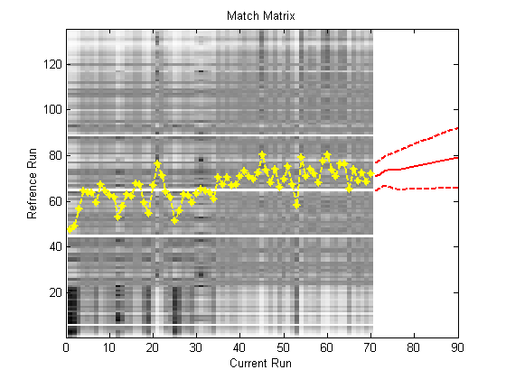
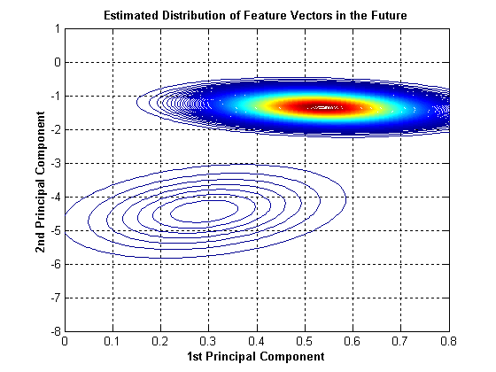
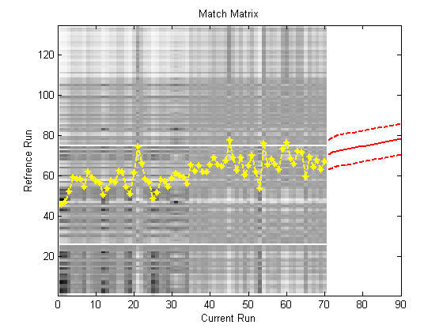
Predicting Feature Distributions
Calculate possible linear combinations of feature vectors at each step ahead
Past
Run1
Past
Run2
Past
Run m
Approximate the distribution of feature vectors using mixtures of multivariate Gaussian distribution at each step
Random sampling inside of the confidence interval
Notes:
To reduce the computation complexity instead calculate all possible combinations of feature vectors, we predict the distribution by randomly sample the prediction confidence interval of mean indices of best match. Then estimate the distribution using Mixtures of Gaussian which can approximate arbitrary distributions to high accuracy.

Slide 10
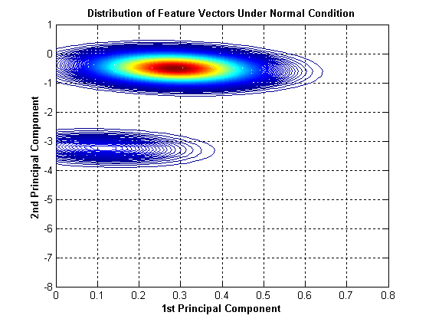
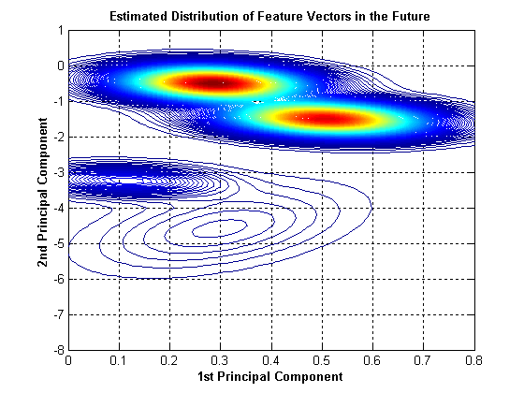
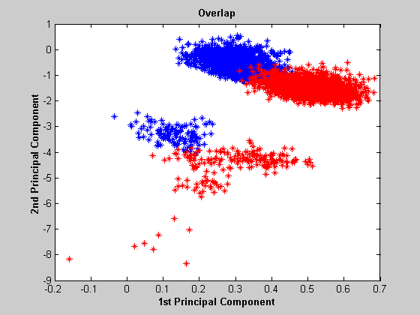
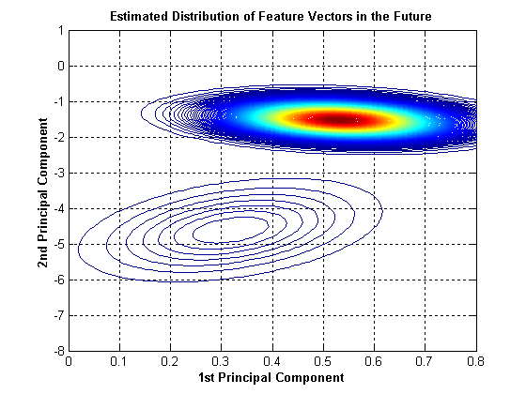
Predicting Performance Confidence Value Using Predicted Feature Distributions
Overlap between two distributions
f₁(x)
Normal
Mixtures of Gaussians
Prediction
f₂(x)
Correlation Coefficient in L₂ space
Notes:
Performance cv ; once we approximate the distribution using Mixture of Gaussian. The overlap can be calculated analytically (correlation coefficient in L2 space)

Slide 11
Presentation Outline
Introduction
Method Overview
Experimental Results
Conclusions and Future Work

Slide 12
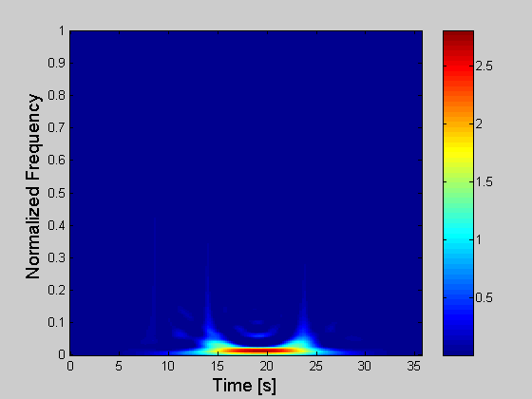
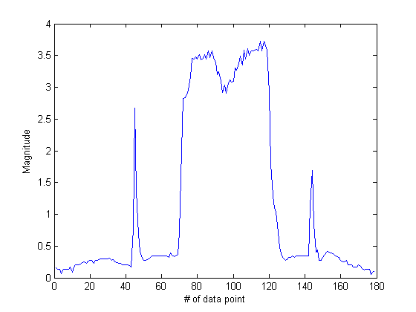
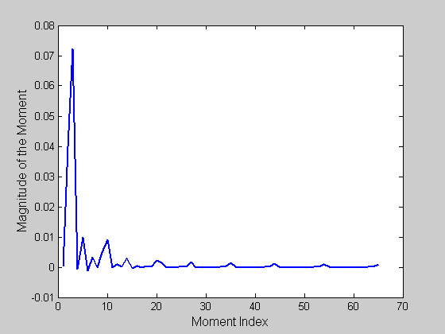
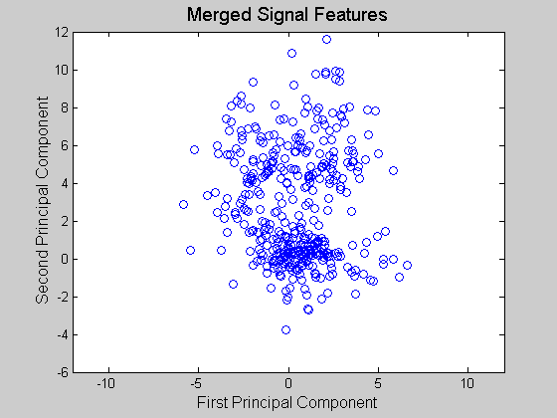
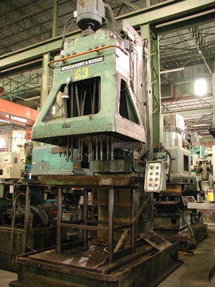
Data Collection and Processing
Time-Frequency Distribution
Spindle Load of a Boring Machine
Sampling rate = 200Hz
TF Moments
Principal Components
Prediction of Process Features

Slide 13
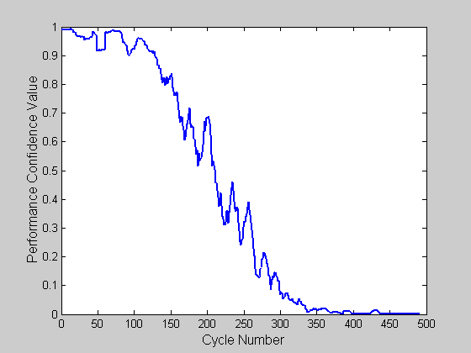
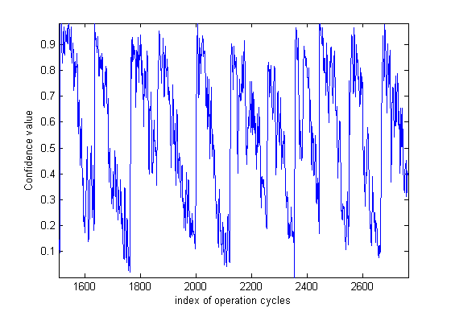
Performance Confidence Values (CV-s)
Performance
Confidence
Value
Normal Behavior
Most Recent Behavior
Most Recent Behavior
Feature Space
One run
Tool Replacement
Notes:
Two weeks data.

Slide 14
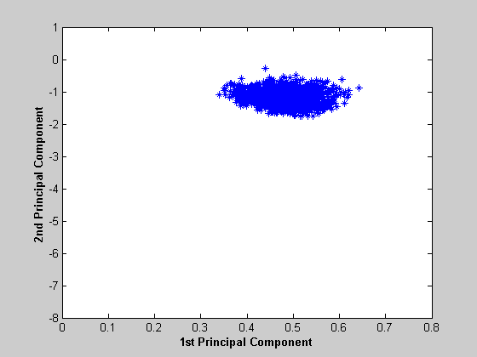
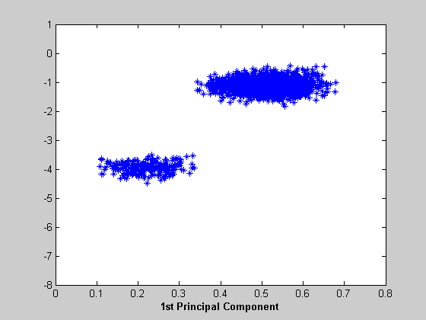

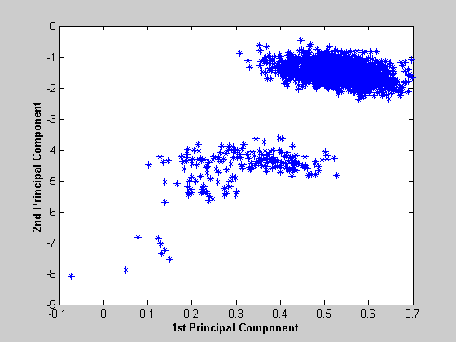
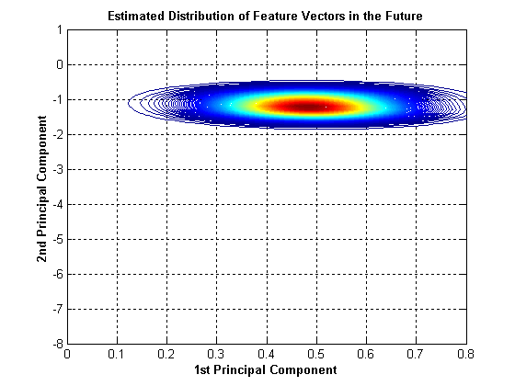
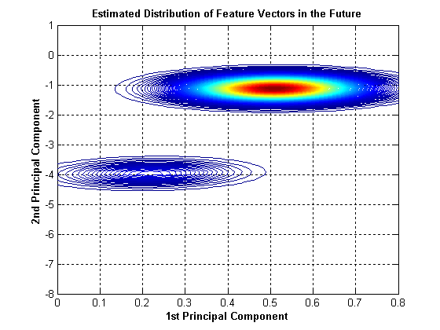


Most Likely Value for the Predicted Features
Possible linear combinations of feature vectors at each step ahead
Predicted feature distributions
Predicted feature distributions
Predicted feature distributions
Predicted feature distributions
1st step ahead
10th step ahead
20th step ahead
30th step ahead
Notes:
Estimate the distribution of features from the prediction confidence intervals.

Slide 15
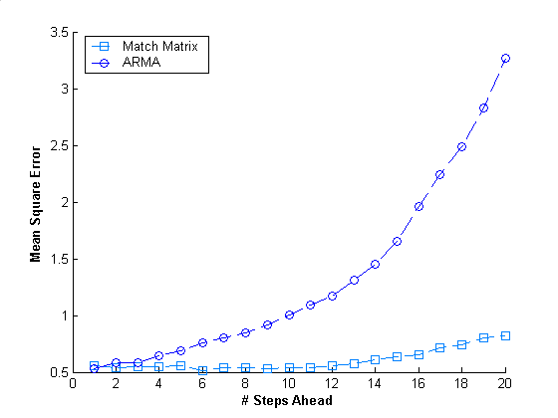
Mean squared error (MSE) Comparison with ARMA Prediction

Slide 16
MSE Comparison with Elman Recurrent Neural Network (ERNN) Prediction

Slide 17
Conclusions
Developed a prediction algorithm that utilizes historical information about equipment performance and yields
Accurate long term prediction of performance features
Ability to predict behavior features described by non-stationary, non-linear, non-Gaussian time series
Full traceability of prediction results
Estimated prediction uncertainty and transformed it into:
Predictions of performance Confidence Values
Probabilities of unacceptable behavior over time

Slide 18
Thank you!

